Slide 2


THE DATASET EXPLORERS
Varun R. Gupta, Amruth Karnam and Nagesh K J

Slide 3

AVOCADOs
/avəˈkɑːdəʊ/
noun
A pear-shaped tropical fruit with green or blackish skin and rich yellowish pulp enclosing a single large seed.
They are Incredibly Nutritious
Contain More Potassium Than Bananas
Loaded With Heart-Healthy Monounsaturated Fatty Acids
Loaded With Fiber
Lowers Cholesterol and Triglyceride Levels
Delicious

Slide 4
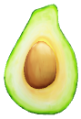
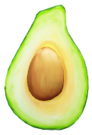
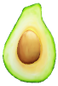
Types of Hass Avocados
PLU: #4046 Small/Medium Hass (~3-5oz avocado)
PLU: #4225 Large Hass (~8-10oz avocado)
PLU: #4770 Extra Large Hass (~10-15oz avocado)

Slide 5
‘NUFF TALK
Onto the Main Dataset!

Slide 6
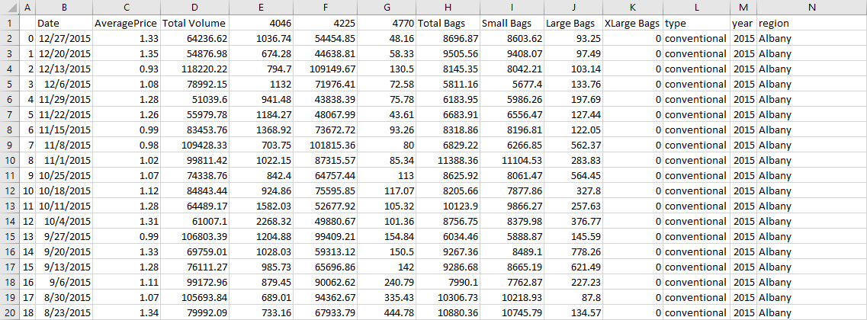
Our Dataset

Slide 7
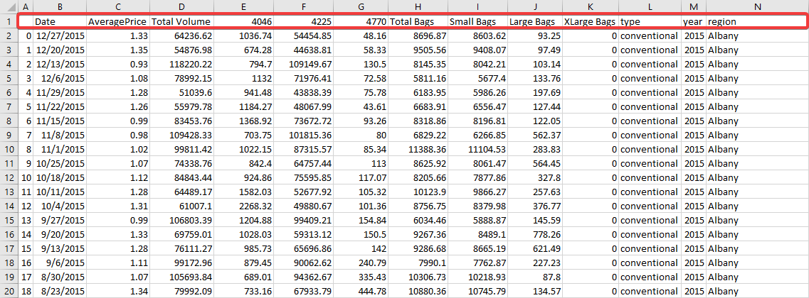
Our Dataset

Slide 8
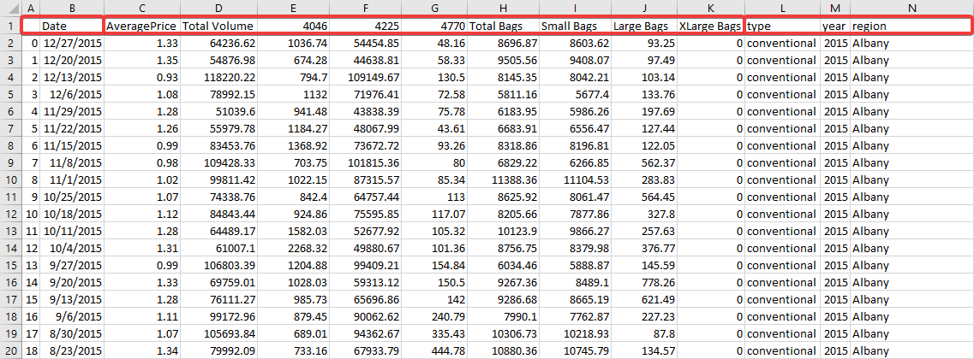
Our Dataset

Slide 9
Our Dataset
Rows: 18250
Columns: 14
2 Index/Timestamp Data Columns
Index
Date of Record

Slide 10
Our Dataset
Rows: 18250
Columns: 14
9 Numerical Data Columns
Average Price
Total Volume
4046
4225
4770
Total Bags
Small Bags
Large Bags
Extra Large Bags

Slide 11
Our Dataset
Rows: 18250
Columns: 14
3 Categorical Data Columns
Type
Year
Region

Slide 12
Our Dataset
Rows: 18250
Columns: 14
2 Index/Timestamp Data Columns
Index
Date of Record
9 Numerical Data Columns
Average Price
Total Volume
4046
4225
4770
Total Bags
Small Bags
Large Bags
Extra Large Bags
3 Categorical Data Columns
Type
Year
Region

Slide 13
Data Cleaning
Before and After

Slide 14
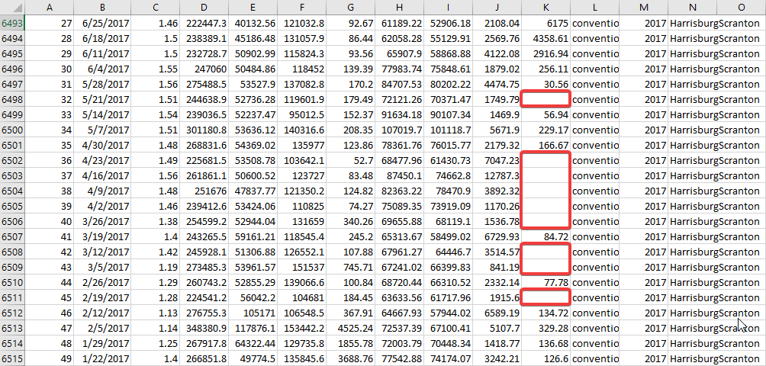
Before

Slide 15
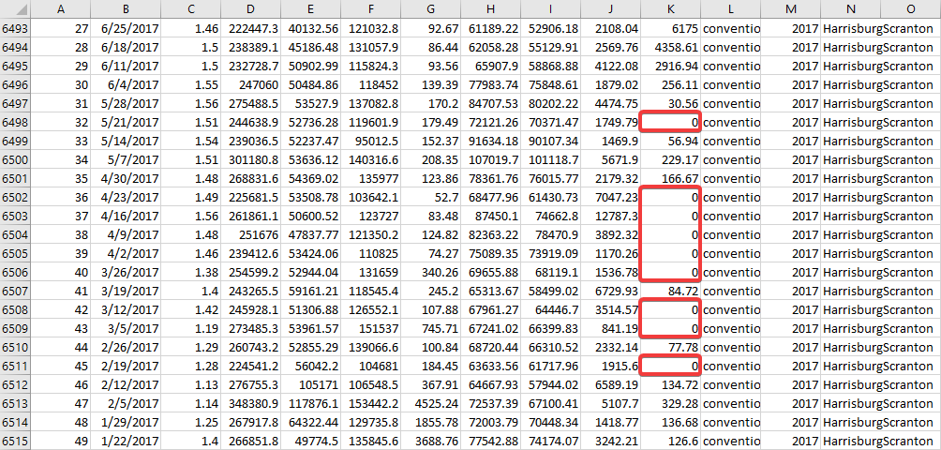
After

Slide 16
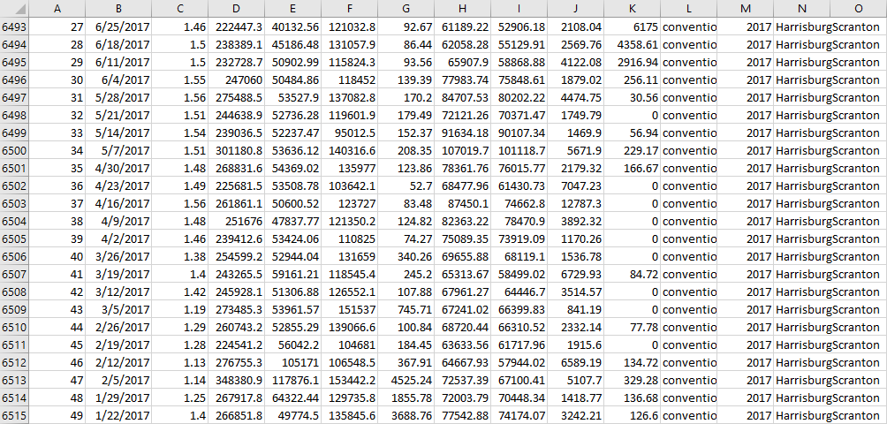
After

Slide 17
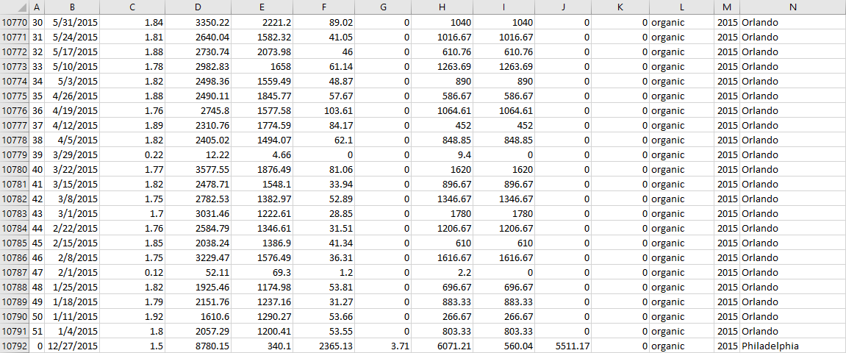
Before

Slide 18
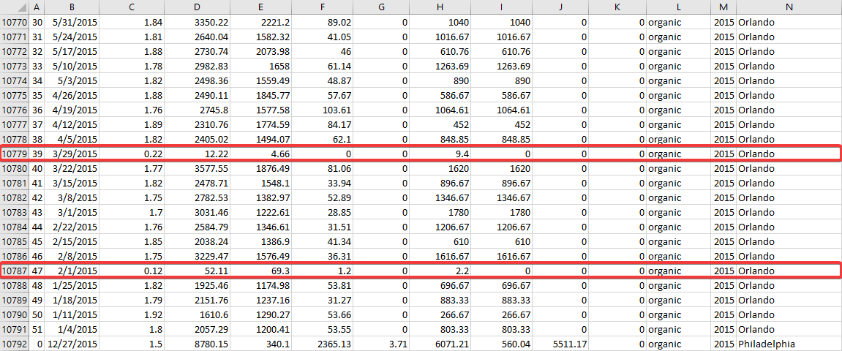
Before

Slide 19
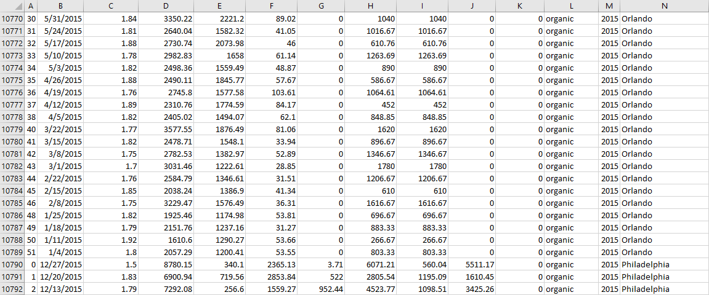
After

Slide 20
NOW FOR SOME VISUALIZATIONS
Let’s Go!

Slide 21
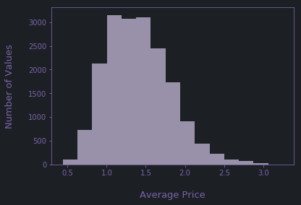
A Histogram of the Average Price

Slide 22
A Histogram of the Average Price
background = "#1C2024"
foreground = "#9991AA"
text = "#7b63ab"
fig = plt.figure(facecolor = background, edgecolor = foreground)
axes = fig.add_subplot(111)
axes.patch.set_facecolor(background)
axes.xaxis.set_tick_params(color = text, labelcolor = text)
axes.yaxis.set_tick_params(color = text, labelcolor = text)
for spine in axes.spines.values():
spine.set_color(text)
plt.hist(df["AveragePrice"], bins = 15, color = foreground)
plt.xlabel("\nAverage Price", color = text, fontsize = 13)
plt.ylabel("Number of Values\n", color = text, fontsize = 13)

Slide 23
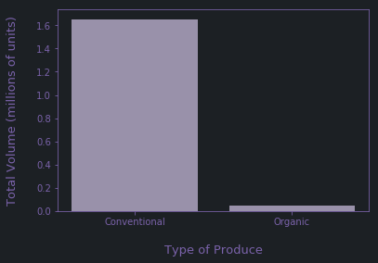
Total Volume of Import (Type of Produce)

Slide 24
Total Volume of Import (Type of Produce)
# Code for the Design Properties
conventional = []
organic = []
for index, row in df.iterrows():
if row["type"] == "conventional":
conventional.append(row["Total Volume"])
else:
organic.append(row["Total Volume"])
plt.bar(["Conventional", "Organic"], [mean(conventional)/1000000, mean(organic)/1000000], color = foreground)
plt.xlabel("\nType of Produce", color = text, fontsize = 13)
plt.ylabel("Total Volume (millions of units)\n", color = text, fontsize = 13)

Slide 25
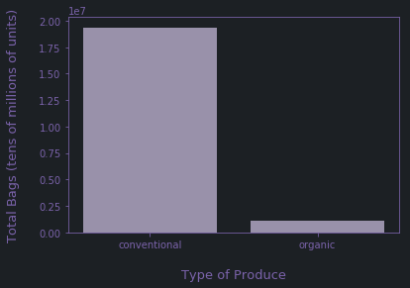
Total Bags of Import (Type of Avocado)

Slide 26
Total Bags of Import (Type of Avocado)
fig = plt.figure(facecolor = background, edgecolor = foreground)
axes = fig.add_subplot(111)
axes.patch.set_facecolor(background)
axes.xaxis.set_tick_params(color = text, labelcolor = text)
axes.yaxis.set_tick_params(color = text, labelcolor = text)
for spine in axes.spines.values():
spine.set_color(text)
plt.bar(df["type"], df["Total Bags"], color = foreground)
plt.xlabel("\nType of Produce", color = text, fontsize = 13)
plt.ylabel("Total Bags (tens of millions of units)\n", color = text, fontsize = 13)

Slide 27
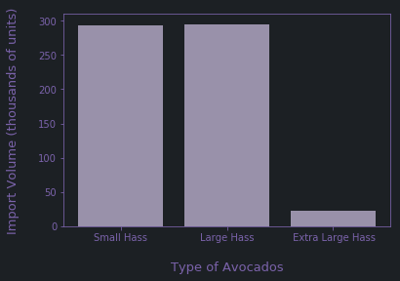
Total Orders of Import (Type of Avocado)

Slide 28
Total Orders of Import (Type of Avocado)
fig = plt.figure(facecolor = background, edgecolor = foreground)
axes = fig.add_subplot(111)
axes.patch.set_facecolor(background)
axes.xaxis.set_tick_params(color = text, labelcolor = text)
axes.yaxis.set_tick_params(color = text, labelcolor = text)
for spine in axes.spines.values():
spine.set_color(text)
sHass = df["4046"]
lHass = df["4225"]
xLHass = df["4770"]
plt.bar(["Small Hass", "Large Hass", " Extra Large Hass"], [mean(sHass)/1000, mean(lHass)/1000, mean(xLHass)/1000], color = foreground)
plt.xlabel("\nType of Avocados", color = text, fontsize = 13)
plt.ylabel("Import Volume (thousands of units)\n", color = text, fontsize = 13)

Slide 29
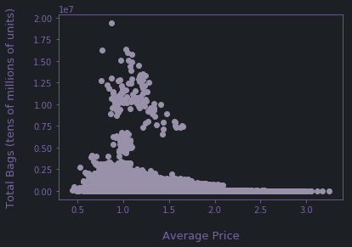
Average Price v/s Total Bags

Slide 30
Average Price v/s Total Bags
fig = plt.figure(facecolor = background, edgecolor = foreground)
axes = fig.add_subplot(111)
axes.patch.set_facecolor(background)
axes.xaxis.set_tick_params(color = text, labelcolor = text)
axes.yaxis.set_tick_params(color = text, labelcolor = text)
for spine in axes.spines.values():
spine.set_color(text)
plt.scatter(df["AveragePrice"], df["Total Bags"], color = foreground)
plt.xlabel("\nAverage Price", color = text, fontsize = 13)
plt.ylabel("Total Bags (tens of millions of units)\n", color = text, fontsize = 13)

Slide 31
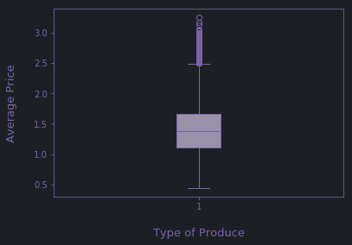
Total Orders of Import (Type of Avocado)

Slide 32
Total Orders of Import (Type of Avocado)
fig = plt.figure(facecolor = background, edgecolor = foreground)
axes = fig.add_subplot(111)
axes.patch.set_facecolor(background)
axes.xaxis.set_tick_params(color = text, labelcolor = text)
axes.yaxis.set_tick_params(color = text, labelcolor = text)
for spine in axes.spines.values():
spine.set_color(text)
bp = axes.boxplot(df["AveragePrice"], patch_artist = True)
for element in ['boxes', 'whiskers', 'fliers', 'means', 'medians', 'caps']:
plt.setp(bp[element], color = text)
plt.setp(bp["boxes"], facecolor=foreground)
plt.setp(bp["fliers"], markeredgecolor=text)
plt.xlabel("\nType of Produce", color = text, fontsize = 13)
plt.ylabel("Average Price\n", color = text, fontsize = 13)

Slide 33
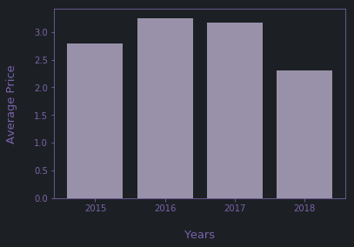
Average Price (Years 2015 – 2018)

Slide 34
Average Price (Years 2015 – 2018)
fig = plt.figure(facecolor = background, edgecolor = foreground)
axes = fig.add_subplot(111)
axes.patch.set_facecolor(background)
axes.xaxis.set_tick_params(color = text, labelcolor = text)
axes.yaxis.set_tick_params(color = text, labelcolor = text)
for spine in axes.spines.values():
spine.set_color(text)
plt.locator_params(axis='x', nbins=8)
plt.bar(df["year"], df["AveragePrice"], color = foreground)
plt.xlabel("\nYears", color = text, fontsize = 13)
plt.ylabel("Average Price\n", color = text, fontsize = 13)

Slide 35
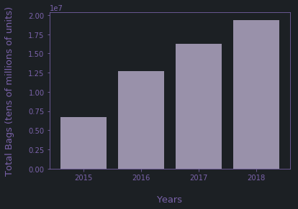
Total Bags (Years 2015 – 2018)

Slide 36
Total Bags (Years 2015 – 2018)
fig = plt.figure(facecolor = background, edgecolor = foreground)
axes = fig.add_subplot(111)
axes.patch.set_facecolor(background)
axes.xaxis.set_tick_params(color = text, labelcolor = text)
axes.yaxis.set_tick_params(color = text, labelcolor = text)
for spine in axes.spines.values():
spine.set_color(text)
plt.locator_params(axis='x', nbins=8)
plt.bar(df["year"], df["Total Bags"], color = foreground)
plt.xlabel("\nYears", color = text, fontsize = 13)
plt.ylabel("Total Bags (tens of millions of units)\n", color = text, fontsize = 13)

Slide 37
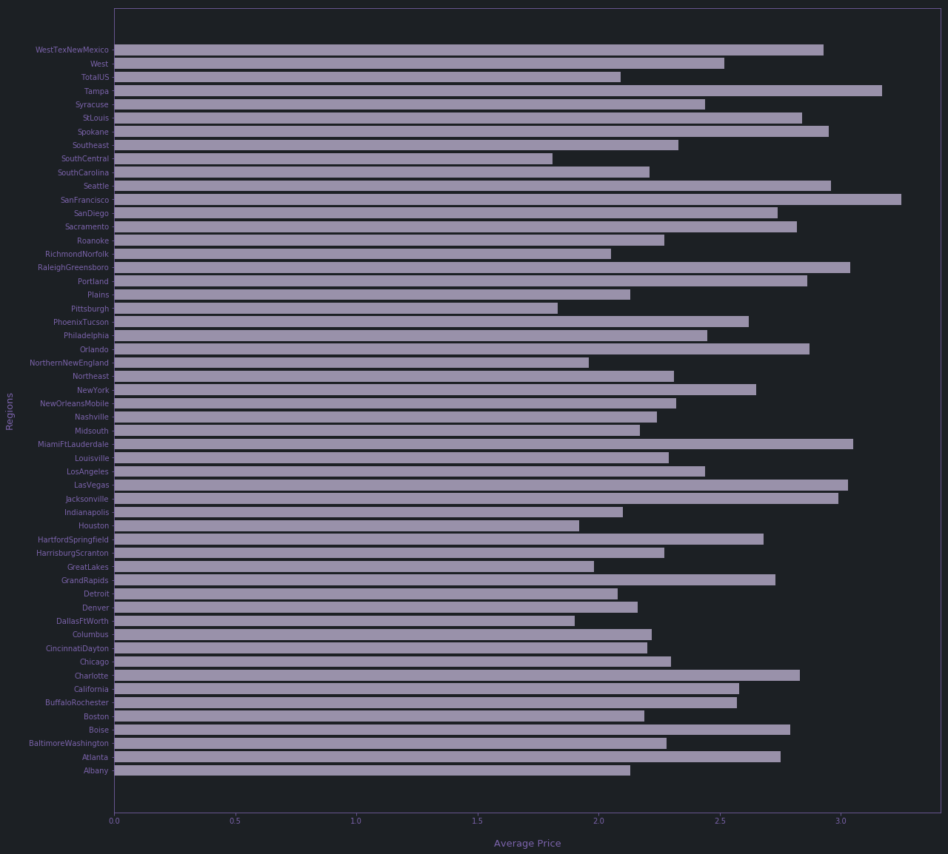
Total Orders of Import (Type of Avocado)

Slide 39
Total Orders of Import (Type of Avocado)
fig = plt.figure(facecolor = background, edgecolor = foreground, figsize=(20, 20))
axes = fig.add_subplot(111)
axes.patch.set_facecolor(background)
axes.xaxis.set_tick_params(color = text, labelcolor = text)
axes.yaxis.set_tick_params(color = text, labelcolor = text)
for spine in axes.spines.values():
spine.set_color(text)
plt.barh(df["region"], df["AveragePrice"], color = foreground)
plt.xlabel("\nAverage Price", color = text, fontsize = 13)
plt.ylabel("Regions\n", color = text, fontsize = 13)

Slide 40
Hypothesis Testing
An Attempt

Slide 41
Hypothesis
'''
Our aim is to check whether the Average Price of the Avocados have increased over the years from 2015 to 2018.
Average Price of 2015 = x
H0: mu0 <= x
H1: mu0 > x
alpha = 0.05
Here mu0 represents the Average Price of 2018.
'''

Slide 42
Execution
_2015 = []
_2018 = []
for index, row in df.iterrows():
if row["year"] == 2015:
_2015.append(row["AveragePrice"])
elif row["year"] == 2018:
_2018.append(row["AveragePrice"])
mean2015 = np.mean(_2015)
smpl = []
for i in sample(range(len(_2018)), 100):
smpl.append(_2018[i])
meanSample = np.mean(smpl)
stdSample = np.std(smpl)
n = 100

Slide 43
Conclusion
w = (meanSample - mean2015)/(stdSample / (100**0.5))
p = norm.cdf(w)
print(p)
# 0.22532387592553987
'''
From the value of p, we can see that it is greater than alpha (= 0.05), hence, we fail to reject the Null Hypothesis i. e. we cannot say that the Average Price of the Avocados has increased over the years from 2015 to 2018.
'''

Slide 44
A Presentation By
PES1201700652 – | Varun R. Gupta
PES1201700266 – | Amruth Karnam
PES1201701528 – | Nagesh K J

Slide 45
Thank You!

